Slide 1

Leading with Purpose: The Role and Impact of an NGC President
NATIONAL GARDEN CLUBS, INC.
Reflections on leadership, service, and organizational growth
Membership Zoom • August 10, 2026 • 3:00 PM ET
Notes:
Welcome everyone, and I am so happy that you tuned in today. The purpose of our get-together is to help you understand what an NGC President does, why the role matters, and how leadership decisions can influence National Garden Clubs for years to come.

Slide 2

What Does the NGC President Actually Do?
The President is far more than the organization's spokesperson. The role combines leadership, governance, vision, relationship-building, advocacy, and stewardship.
ZOOM ENGAGEMENT
Enter one word in the chat: when you think of the NGC President, what comes to mind?
Leadership
Governance
Vision
Relationships
Advocacy
Stewardship
Notes:
Ask the group: when you think of the NGC President, what comes to mind? Invite one word in the chat. Then explain that the role is a blend of all six of these dimensions, not just being the public face of NGC.

Slide 3
The Scope of the Role: A National Position with Local Impact
Per the Bylaws, the President serves as the official representative of NGC and Chairman of the Board.
RESPONSIBILITIES
FACT
One presidential decision can influence thousands of members, hundreds of clubs, and communities across the country — for example, the PLANT AMERICA Matching Grant.
Provides strategic leadership
Supports state and region leaders
Represents NGC nationally and internationally
Presides over board and executive committee meetings
Guides initiatives and priorities
Maintains relationships with affiliates and partners
Notes:
Anchor the role in the Bylaws: official representative of NGC and Chairman of the Board. Walk through the responsibilities, then land the fact — one decision reaches thousands of members. Use the PLANT AMERICA Matching Grant as the example.

Slide 4
Leadership in Action: Wearing Many Hats
Leader
Listener
Ambassador
Problem Solver
Motivator
Stewardship Manager
BEHIND THE SCENES
Building consensus — agreement and cooperation
Answering member concerns
Encouraging volunteers
Helping state leaders succeed, which helps clubs succeed
Notes:
Much of a president's work happens behind the scenes: building consensus, answering member concerns, encouraging volunteers, and helping state leaders succeed — which in turn helps clubs succeed.

Slide 5
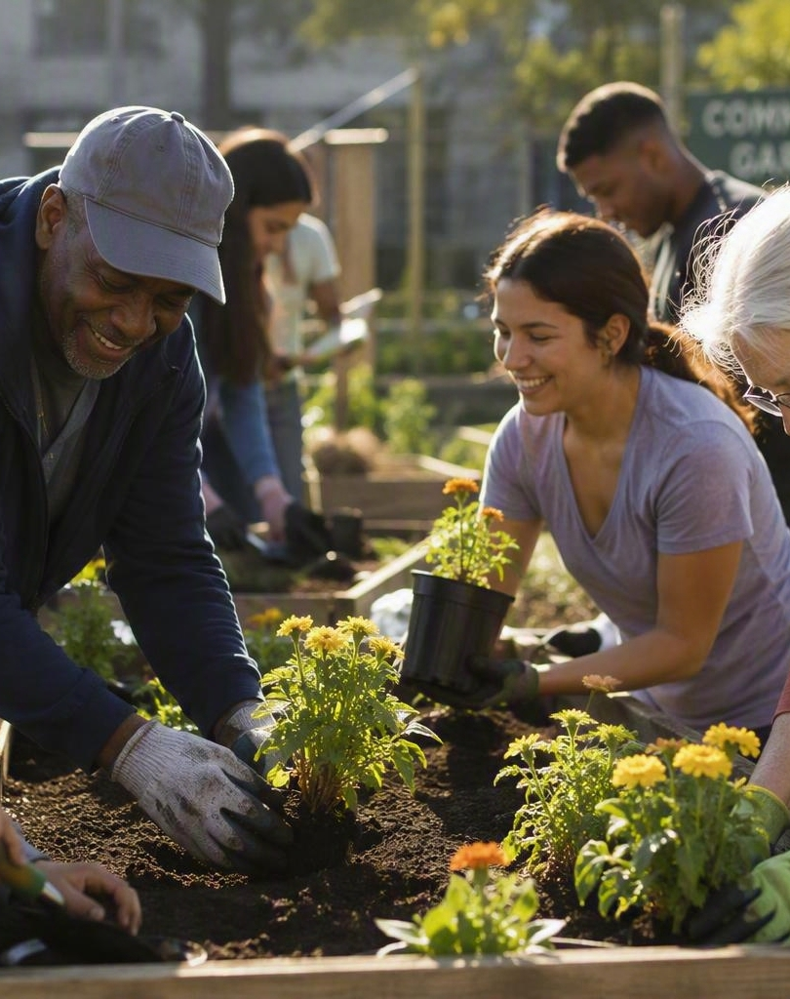

PLANT AMERICA and Mission Impact
Turning vision into action
Environmental stewardship
Community beautification
Education
Youth engagement
Gardening activities at state and club level
TAKEAWAY
The true measure of success is the impact clubs make in their communities through mission-driven projects.
Notes:
Ask: how many of you know about, participated in, or considered the PLANT AMERICA Matching Grant? How can that message get out better? Connect PLANT AMERICA to stewardship, beautification, education, youth, and club-level gardening.

Slide 6
Strengthening the Organization: Governance Matters
The NGC Bylaws and Standing Rules are currently under review. Here is why.
Clarity and sustainability
Clearing out confusing repetition throughout the documents.
Planning for future leaders
Making it easier for anyone in NGC to understand the documents.
Organizational effectiveness
The standard NGC needs to achieve going forward.
ZOOM POLL
What does this review mean to you? State presidents, club presidents, and members all need to understand why it was undertaken and the benefit of the work.
Notes:
Explain that the hard part of the review is earning approval. Members need to understand the reason it was undertaken and the benefit. Run the poll: what does the review mean to you?

Slide 7
The Review: How We Got Here
ORIGIN
As 3rd VP, I could not in good conscience justify the documents at the end of the term. President Mary Warshauer began planning a full review; time ran short. This administration picked it up.
Bylaws: 23 pages to 6
Standing Rules: 26 pages to 8
STEP ONE
The Special Committee studied the NGC Articles of Incorporation — our birth certificate — which provided a solid foundation for the work by identifying the goals and purposes originally set forth for the organization.
What remains in both documents is the core of what our foremothers planned. The rest now lives in the Policy Manual, where it belongs. Focus groups will follow — watch for the dates.
STEP TWO
Clear the Bylaws of ambiguous and redundant wording and move actual policy out of the document, leaving NGC's true governing language.
FACT
Strong governance helps make sure NGC can continue serving members for generations.
Notes:
Walk through the origin and the two steps. Emphasize the results: Bylaws 23 pages down to 6, Standing Rules 26 down to 8. Ask whether members have experienced looking up an item only to find it repeated elsewhere in a different context. Pause for questions.

Slide 8

Connecting Across America
Bringing members together
State conventions
Club visits
Zoom meetings
As President, I have had the privilege of visiting members from coast to coast — and everywhere I find the same enthusiasm, dedication, and commitment to gardening, community service, and the NGC mission. Members value hearing directly from the President and are eager to get involved and share the NGC story.
FACT
Every state brings unique strengths to the National Garden Clubs family.
Notes:
Personal story: visiting members coast to coast. The same enthusiasm everywhere, regardless of audience size. Members want updates on initiatives, programs, and projects, and want to know how to get involved and make an impact locally.

Slide 9

Representing NGC Beyond Our Borders
Building international relationships
International affiliates
Cultural exchange
Shared environmental goals
Friendship through gardening
TAKEAWAY
Gardening is a universal language that connects people around the world.
Notes:
NGC's international affiliates extend the mission well beyond our borders — cultural exchange, shared environmental goals, and friendship through gardening.

Slide 10
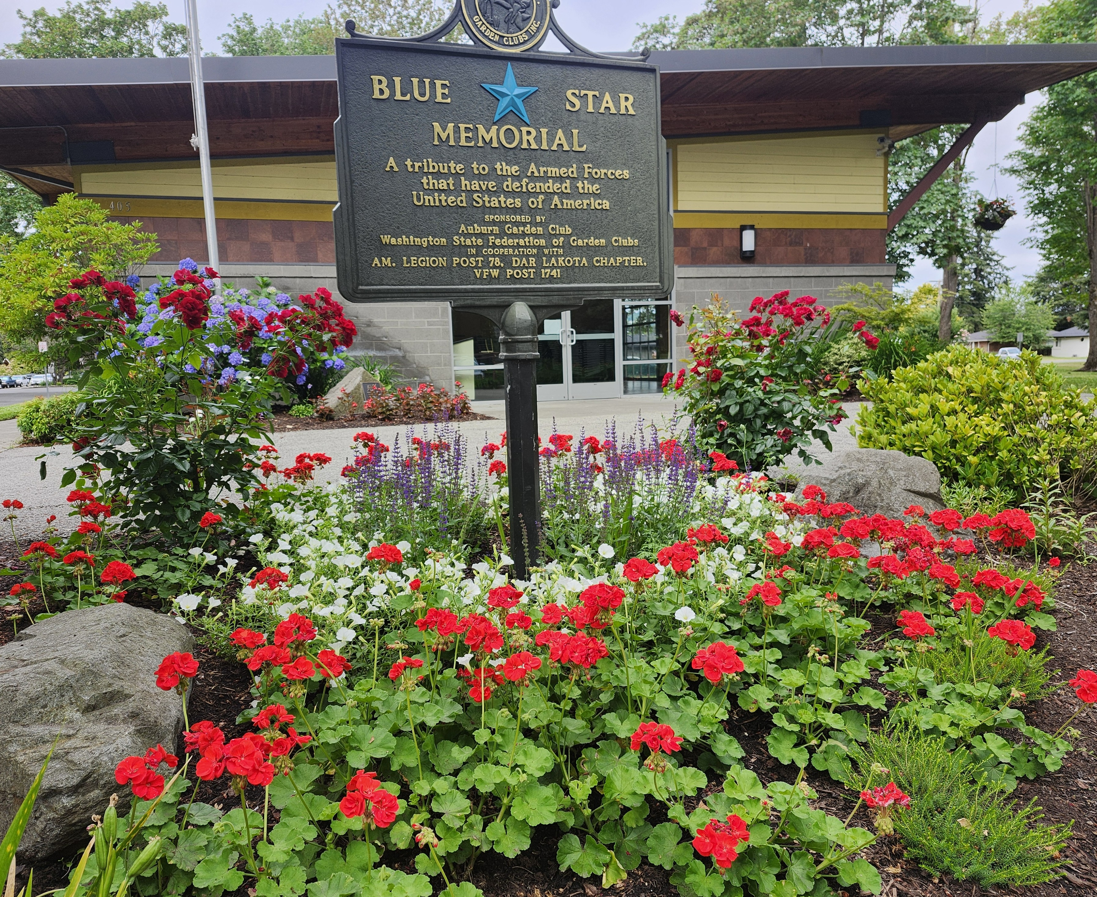
Preserving History, Honoring Service
Connecting the past to the future
Blue Star and Gold Star Memorial projects
Honoring veterans
Historical commemorations
Celebrating NGC traditions
TAKEAWAY
Organizations grow stronger when they honor their history while preparing future leaders.
Notes:
Our Blue Star and Gold Star Memorial projects, veteran recognition, and historical commemorations keep NGC's traditions alive while we prepare the next generation of leaders.

Slide 11
Five Leadership Lessons
1
Relationships matter.
2
Volunteers are our greatest asset.
ASK ATTENDEES
Which lesson resonates most with you — and how has it shaped your work within your garden club?
3
Communication builds trust.
4
Change and tradition can coexist.
5
Service creates lasting impact.
Notes:
Invite responses: which lesson resonates most with you, and has it impacted your work within your garden club?

Slide 12
The Real Impact: Beyond One Presidency
The most important achievement of any president is not an individual accomplishment. It is helping members feel connected, valued, empowered, and prepared to continue the mission.
FINAL TAKEAWAYS
NGC succeeds because of volunteers.
Local projects create national impact.
IN CLOSING
“The greatest privilege of serving as the 49th NGC President has been witnessing what dedicated members can accomplish when united by a common purpose.” And that common purpose is PLANT AMERICA.
Leadership is service.
Every member contributes to the future of NGC.
Notes:
Close the substance of the talk: the measure of a presidency is whether members feel connected, valued, empowered, and prepared to carry the mission forward.

Slide 13
Thank You
Thank you for attending today and for the important role each of you plays in advancing the mission of National Garden Clubs. Together we are making a difference in our communities and building a strong future for our organization.
Questions are always welcome — please reach out by email. Enjoy the rest of the summer, and continue to PLANT AMERICA with seeds of beauty, education, and service wherever you go.
Notes:
Thank attendees for their time and their role in advancing the NGC mission. Invite follow-up questions by email and close with the PLANT AMERICA send-off.

